Slide 1
Creating your own movement breaks

Slide 2
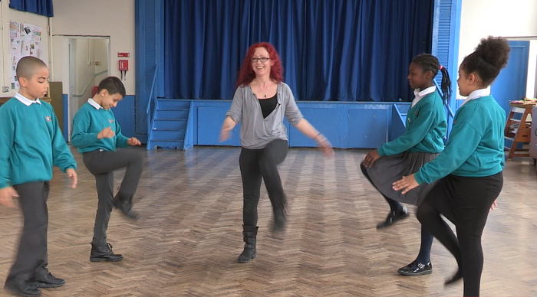
Examples of Resistance and Weight Bearing Movement Breaks – Shown in Videos
Example 6 Creating your Own. These children chose:
1. Bend forward hinging from waist with arms outstretched and back 5 times.
2. Bring knee up and touch with opposite hand 10 times.
3. Squats to stand 10 times.
4. Kneeling on floor and walking to stand one leg at a time 5 times
5. Stand up and stretch to the ceiling for 10 seconds.

Slide 3
Getting started - Selecting the Right Kind of Movement
Now you have followed some of the movement break sequences on this site, you might be ready to create your own either by yourself or involving your learners.
There are many different types of movement breaks that support the body’s sensory and physical systems in all sorts of ways.
Movement activities which support the proprioceptive system in particular have lots of effects. For example, they can be calming, and support attention.
As a general rule, movement that is up and down and side to side is more calming than rotating (spinning), fast and angular movements which can have a more stimulating/alerting effect.

Slide 4
Getting started – More things to keep in mind
Resistance, stretching and weight bearing activities are most effective.
Very aerobic activities are supportive only when the class/learners are particularly sluggish
Single activities or a combinations of activities can be equally appropriate depending on the learners and your set up.
Don’t forget to download music from LGfL’s copyright free database of thousands of music tracks at http://audionetwork.lgfl.net so pupils can do activities to music if you choose. This can add a nice additional feature to movement breaks.

Slide 5
Additional Resistance and Weight Bearing Movement Examples
Push up on a chair
Push hands together and squeeze
Make an arch with their arms with a partner and push
Pupils in pairs push on each other shoulders
Do press ups on floor or against a wall or desk
Lift 2 balls or beanbags above their head 10 times
Tug of war
Pass a heavy ball up and down groups of children

Slide 6
Additional Stretching Movement Examples
Stand up and stretch to the ceiling!
Yoga movements
Leg stretches
Back and arm stretches
Gentle neck and head rolls (be particularly careful here)

Slide 7
Examples of Aerobic Movement Activities (To Energise after Periods of Quiet Learning/Sitting)
Jump on the spot
Lift left knee and touch with right hand and swap to the other side
Sit down and stand up
Shake partners hand and turn back and shake other partners hand
Marching or running on the spot
High kneeling to stand
Star jumps marching
Shake or dance breaks

Slide 8
Hand and Arm movement Examples Before writing (See Section 2 of this resource)
Finger wiggles
Clapping sequences
Squeeze hands together
Run fingers up and down the table
Pincer/release
Close and open hands
Roll hands over pencil
Interlock fingers and stretch to ceiling

